Slide 1
Robotic tracked tissue sensing for tumor bed inspection
Coleman Farvolden, Kian Hashtrudi-Zaad, Laura Connolly, Gabor Fichtinger
Notes:
Test bed, no tracked, inexprensive

Slide 2
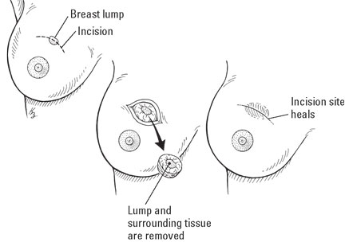
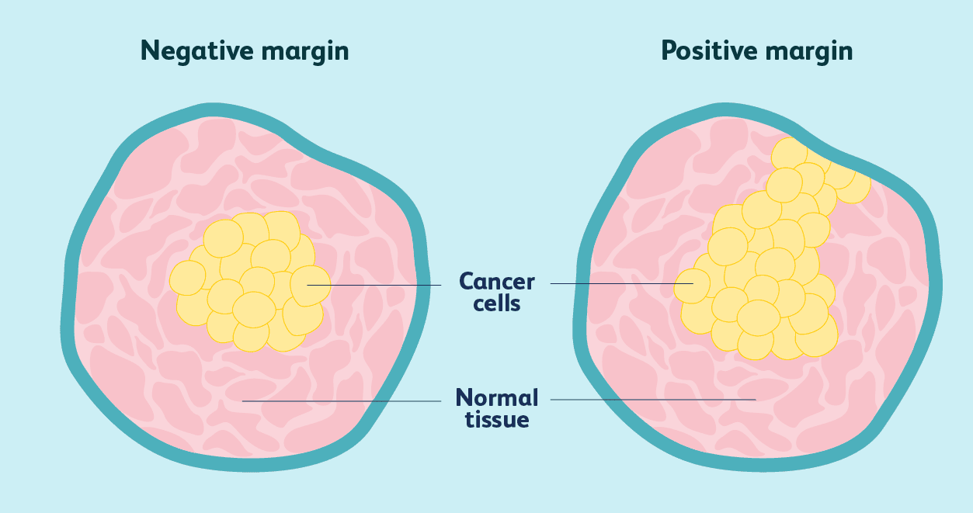
Background
Breast cancer is one of the most common surgically treated cancer in women
Breast Conserving Surgery is a primary treatment option
20-30% of cases need revision surgery
https://www.dummies.com/article/home-auto-hobbies/food-drink/recipes/cancer-recipes/breast-cancer-surgeries-246228
https://https://www.verywellhealth.com/how-surgical-margins-affect-breast-cancer-decisions-430114
Notes:
Presentation notes:
Point 1: BC most common
Point 2: BCS, primary treatment option. Goal to minimize healthy tissue loss.
Point 3: Reference second diagram. Up to 30% of cases have a positive margin. Need revision surgery. (Hargreaves 2014)
Point 4: Results in significant physical, emotional, and financial stress.
Point 5: One of the ways we can help deal with this is by recognizing if there is any cancer left in the cavity

Slide 3

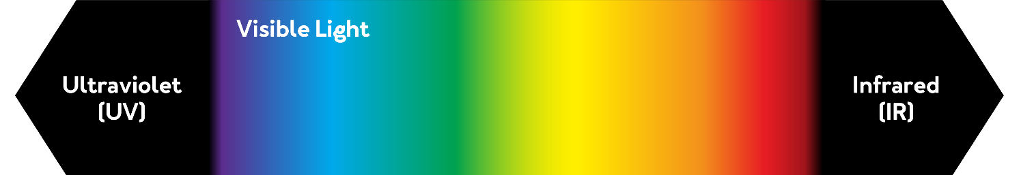
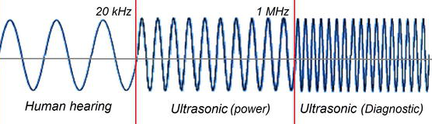
Tissue Recognition
Using various properties to characterize and differentiate tissues
Chemical
Electromagnetic
Structural
Notes:
- My focus is in the optical domain

Slide 4
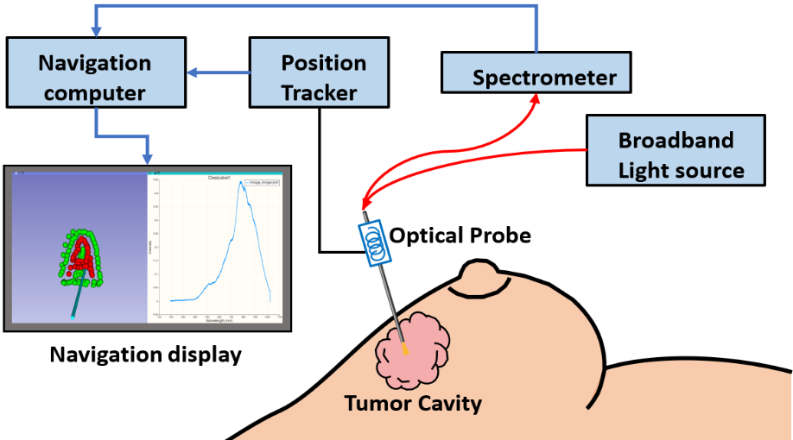
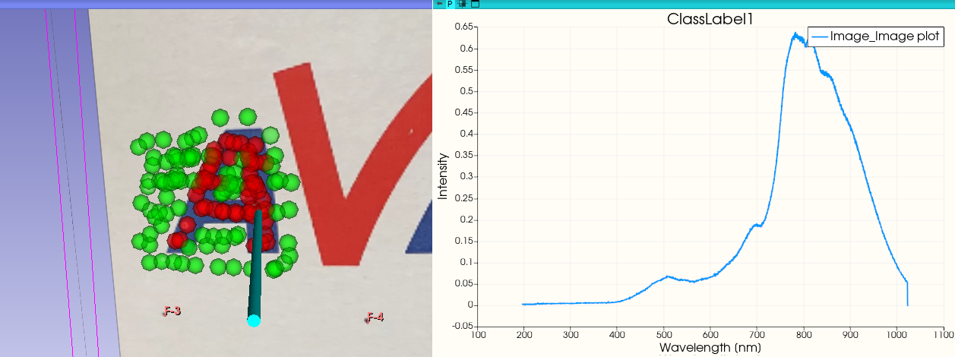
Tissue Classification platform
Focus:
Live classification of spectra
Localization of the classification (EMT)
Interface with 3D tracked probe (Slicer + PLUS)

Slide 5
Objective: Intraoperative spectrometry tissue classification with a robot

Slide 6
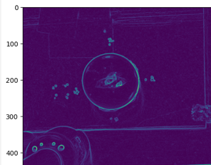
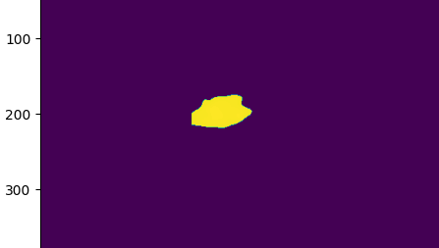
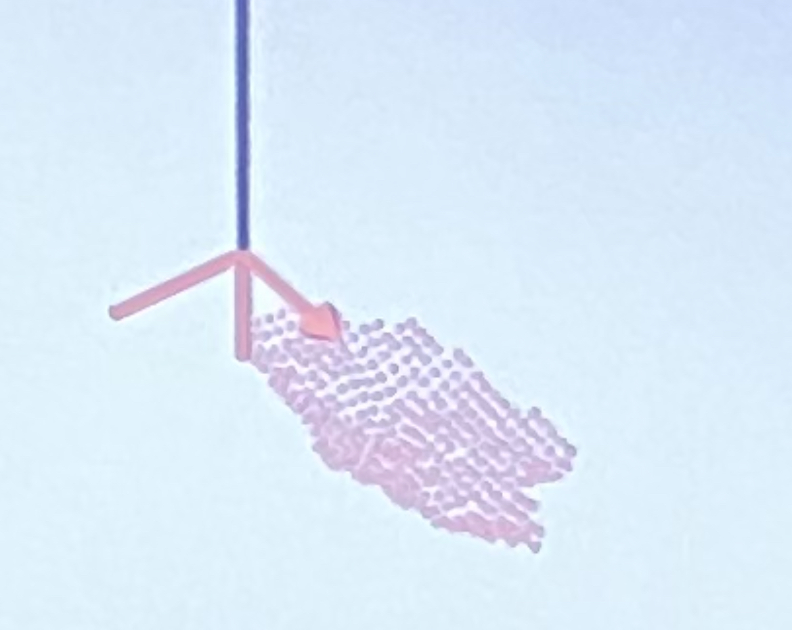
Methods - Slicer module
Utilizes a depth-scanned image obtained from an Intel RealSense camera.
The depth image is then converted using a Jupyter notebook into a point cloud representation of the cavity.
Slicer is then able to send each point of the point cloud to move the robot to the desired position using Slicer-Ros2
The optical data from the spectrometer and the 3D position data from the robot are sent to the 3D Slicer module using PLUS and an OpenIGTLink
Slicer module classifies each point in 3D space as cancerous and non-cancerous with spectrometer data

Slide 7
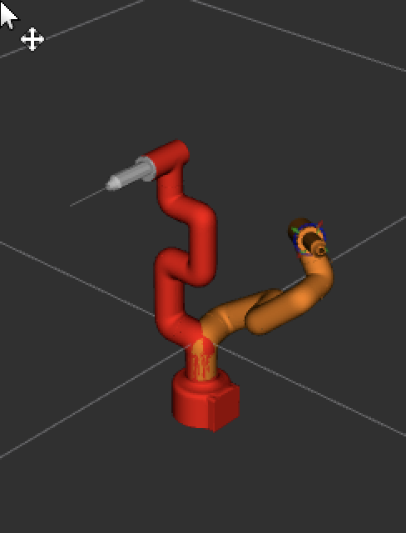
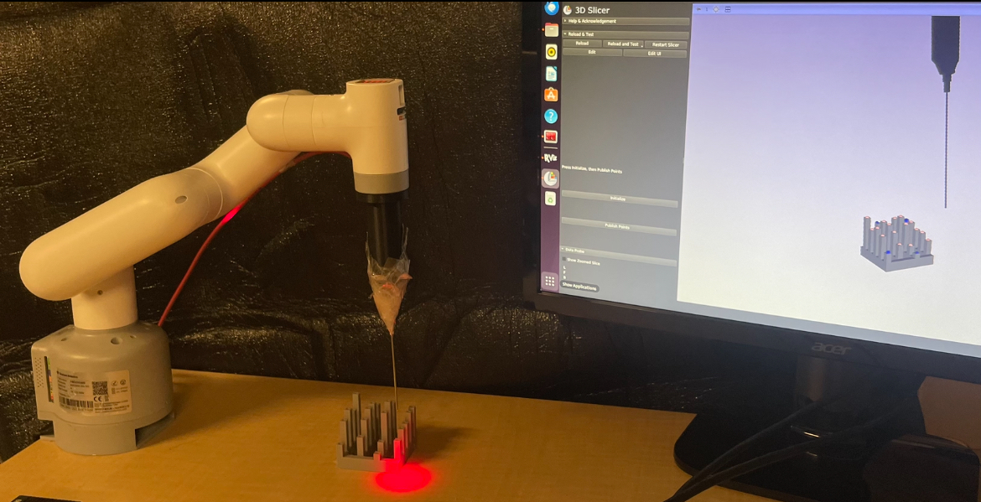
Methods – Robot
The robotic arm is controlled using ROS2 Humble, an open-source robotics platform
A desired end defector pose (end of the robot position) is sent to the robot from slicer
This desired position is executed using MoveIt2, a powerful motion planning framework within ROS
The robot iterates through each point in the cloud, scanning the entire tumor cavity

Slide 8
Methods – Overview of workflow
Windows
Slicer
Linux
Linux
Slicer
Windows
OpenIGTLinkIF
OpenIGTLinkIF
Camera
MyCobot
MyCobot
Mass Spectrometer
EM
Breast

Slide 9
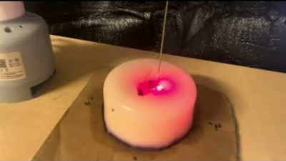
Video of scanning

Slide 10
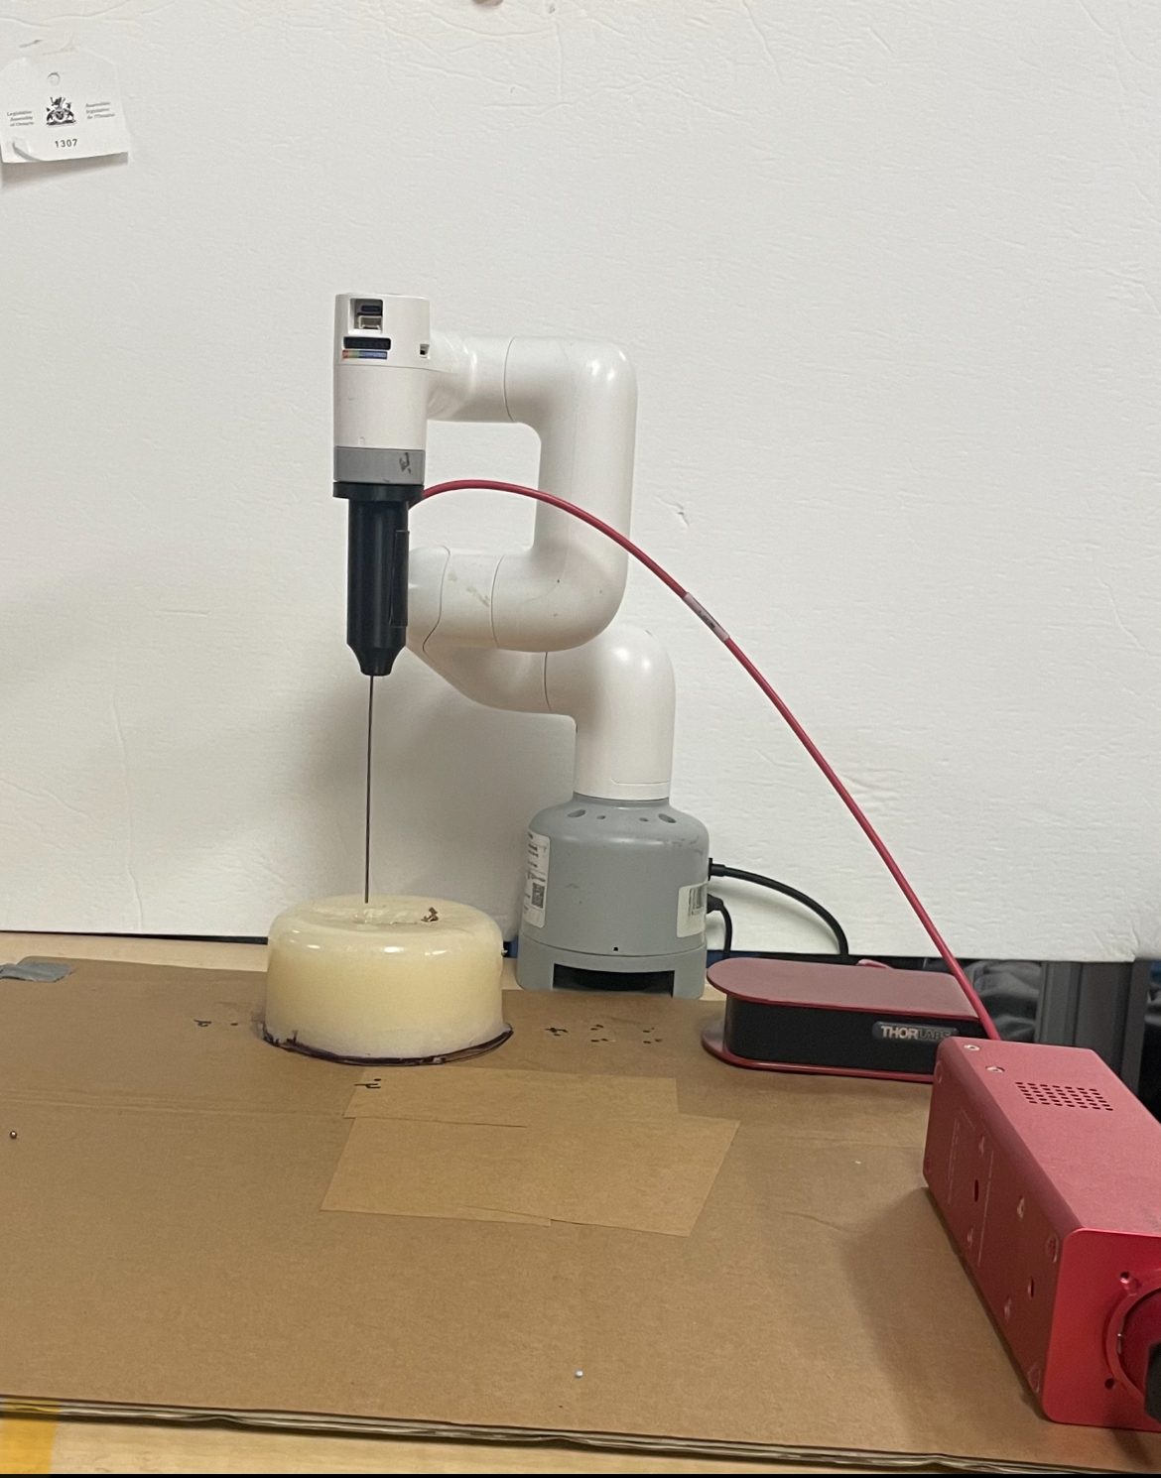
Conclusions
A robot could possibly be used to complete an automated tissue scan with higher accuracy then a human
There is now a 3d slicer module that can move a robot to desired positions
There is now a platform to send a robot with any tool to points in a cavity

Slide 11
Limitations
Robot purchased is inexpensive and carries a positional error
Robot hardware interface may contain error in positional data
The notebook for converting depth image to point cloud may have inaccuracies
Spectrometer is physically bent

Slide 12

Thanks For Listening

Slide 13
Methods – Overview of workflow
Linux
Slicer
Windows
OpenIGTLinkIF
Pose
PLUS
MyCobot
Mass Spectrometer

